Slide 1
Innovators in Direct Digital Control Systems
Since 1986

Slide 2

Pioneered innovations in Direct Digital Control
Developed first Distributed Database and Control Hardware microprocessor based VAV controller
Provided early methods of Open Systems Interoperability
ASIC/3 and ASIC/1 controllers, ENC and EKW control panels, ASI software, PS Power Meters, WS and TS Sensors include a 5 year limited warranty. All Other Products are covered by ASI Controls standard warranty which extends 12 months from date of installation or 18 months from date of purchase, whichever is sooner

Slide 3
ASI Controls – An Industry Innovator Since 1986
The most rugged and reliable controls in the industry.
Lowest total cost of ownership (TCO), thanks to backwards compatibility, industry-leading interoperability and a commitment to future compatibility.
Unprecedented commitment to the success of our partners and their customers.

Slide 4
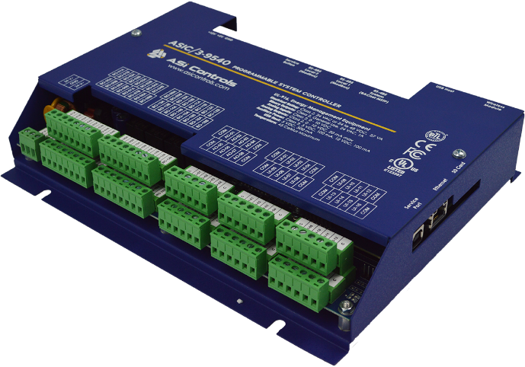
The Most Rugged and Reliable Controls in the Industry
Strong Enough for Hurricane Katrina
When Hurricane Katrina hit New Orleans, the enclosure protecting an ASIC controller blew open, exposing the equipment to the fury of the storm.
Afterward, our system integrator Star Service dried out the controller and powered it up. The unit roared to life, returning service to the building’s chiller.
Another manufacturer’s controller on the same roof didn’t survive the hurricane; the building’s management was quick to install a new ASIC controller in its place.

Slide 5
Lowest Total Cost of Ownership (TCO)
Our commitment: While other manufacturers build limitations into their direct digital products, we design and build ours to be reliable and functional for years to come. We believe true value comes not in forcing our clients to purchase new devices every few years, but in creating a product that provides such superior performance that they will seek us out for future projects.
1
Backwards
Compatibility
2
Industry-Leading Interoperability
3
Future
Compatibility
Combined with the rugged, long-lasting design of our devices, this means our controllers won’t have to be replaced every time you upgrade or retrofit an installation.
You’ll have the advantage of choosing a high-quality ASI Controls product as an upgrade for a wide range of non-ASI products, enabling you to reap all of the benefits of our products without having to fully replace your installation.
ASI Controls is building a new framework that will enable our customers to take advantage of cloud-based services and other cyberspace advances - all without sacrificing the backward compatibility our products are known for.

Slide 6
Our Commitment to Your Success
Unrivaled Customer Service
Our service experts have years of field experience and are committed to the fastest possible resolution for your requests.
Our partners regularly rank the personalized service, education, and care they receive from ASI Controls above any other digital control provider they have ever worked with. Our commitment to support our products and our partners runs through the entire sales and ownership cycle. We demonstrate our dedication not only by building the most rugged and reliable controls, but by ensuring that our resale partners are able to grow and successfully support their customers, the end-users. ASI Controls also offers unparalleled direct-to-end- user support to ensure satisfaction and quality every step of the way.

Slide 7

ASI Controls Market Channels
Value Added Resellers (VARs)
Domestic and International.
Strategic partnerships
CCAC and Daikin Applied Southeast.
Original Equipment Manufacturers
Century Corp. Chillers Absorption, Centrifugal, Screw.
National Accounts Through VARs
Hilton Hotels, Dillard's dept. stores, Century Link, Verizon
SafeGuard Storage, Dilweg Properties.

Slide 8

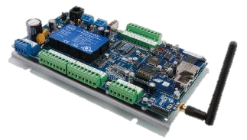
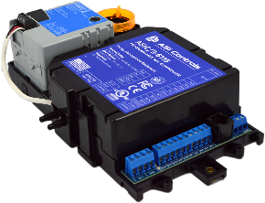
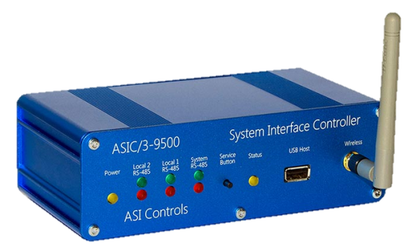


ASIC/3 Fully Programmable Controls
Suitable for Chillers, Boilers and all Central Plant & Customized Applications
Configuration resides in controller in a non-compiled format in flash memory
Universal inputs, analog outputs, relays rated at 24 VAC, 1 Amp
IP addressable with expandable network options, Wi Fi capable
RS-485 communications with Modbus RTU and BACnet MS/TP

Slide 9

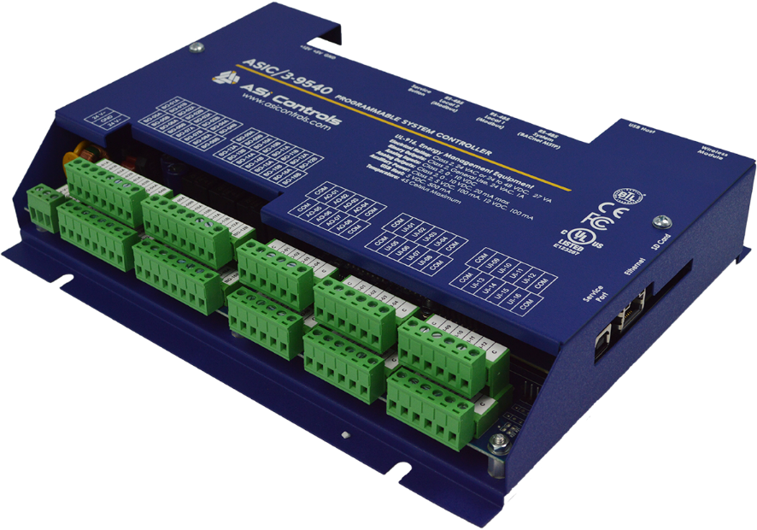
ASIC/3-9540 Programmable
16 universal inputs, 16 binary + 8 analog outputs
Software-selectable protocols, BACnet IP, MS/TP, ASI Legacy, Modbus RTU
BACnet MS/TP routing
100Mb Ethernet and optional wireless
Data storage –Trending
On-board non compiled configuration
USB Device Service Port
Demand object, pulse count & smart meters.

Slide 10
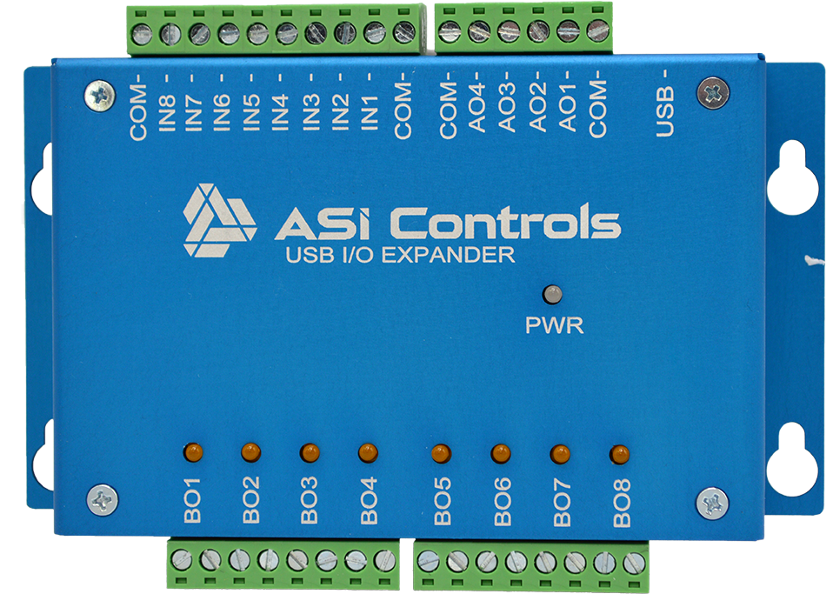

ASIC/3-USBIO USB IO Expander
A low-cost, easy to implement I/O expansion for some ASIC/3 programmable controllers
Eight universal 0-10Vdc inputs
Eight pilot duty relay outputs
Four analog 0-10Vdc outputs
USB powered
Plug and play connectivity
Second module added via powered USB hub
Compact, low profile design

Slide 11
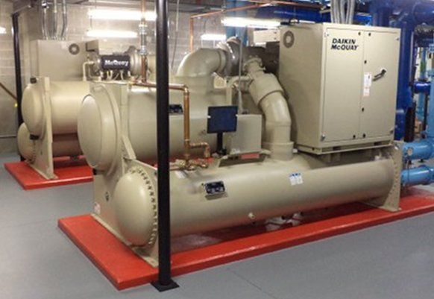
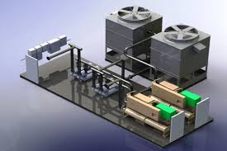
Typical Applications, Central Plant Control and Energy Solutions
Chilled water, hot water plants with pumps and cooling towers.
Water loop temperature resets based on ambient conditions.
Chiller optimization, part loads, lead lag equipment life.
Pump and tower fan VFDs.
Tower fan speed based on temperature.

Slide 12
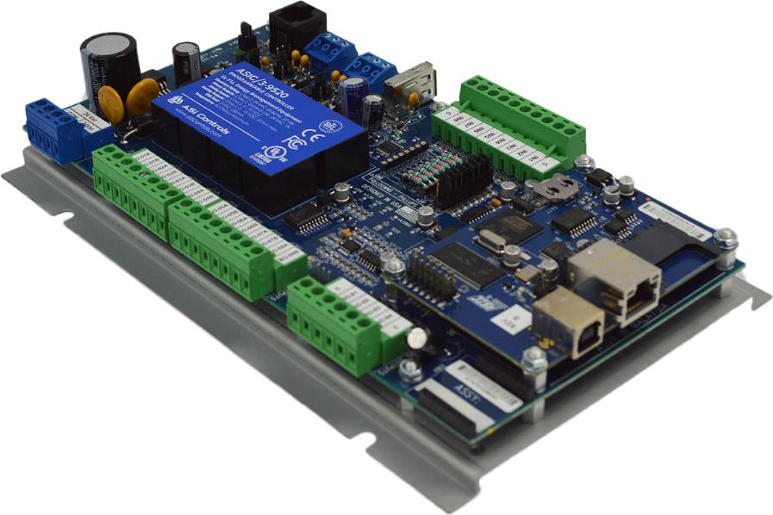
ASIC/3-9520 Programmable
8 universal inputs, 4 analog & 8 binary outputs
Software-selectable protocols, BACnet MS/TP, ASI Legacy, Modbus RTU
100Mb Ethernet and optional wireless
Data storage –Trending
On-board non compiled configuration
USB Device Service Port
Notes:
Air handlers and complex RPUs

Slide 13
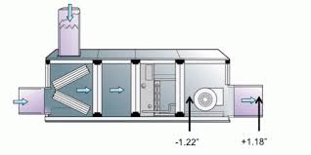
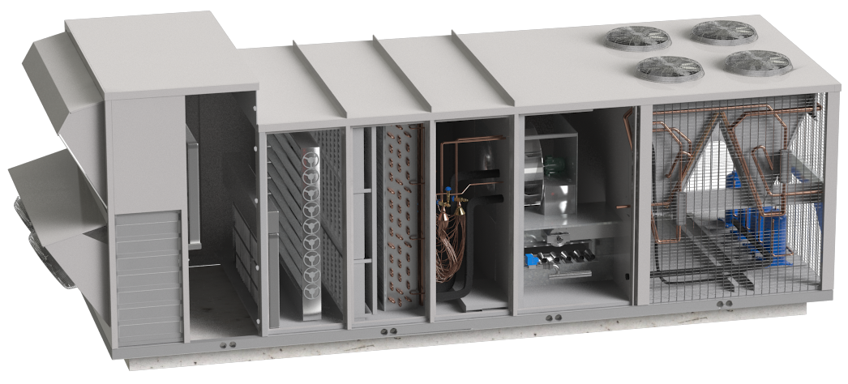
Typical Applications, Air Handler and Custom Equipment
Midsize point count applications.
Typically air source for networked VAVs.
Variable Frequency Drives on fans.
Outside air, makeup air, CO2 based modulation. Comparative Enthalpy.
Energy Recovery Ventilation.

Slide 14

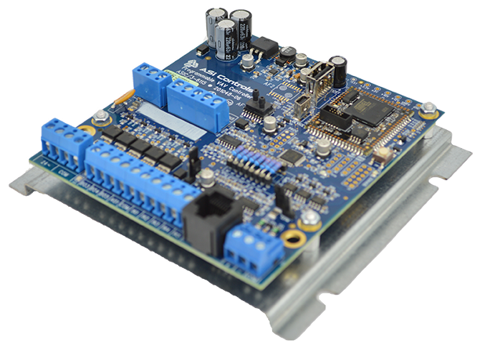
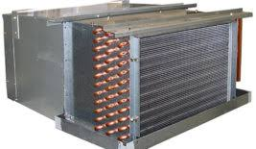
ASIC/3-6115-MB BACnet Programmable
A small footprint BACnet programmable that combines the proven functionality of an ASI terminal controller with the full power of the ASIC/3 object-based system controllers.
32-bit ARM9 processor
RS-485 port ASI or BACnet MSTP communication
Compatible with Intellifront, ASI WebLink & Niagara
8 Universal 0-10Vdc Inputs
5 Binary Triac Outputs
2 Analog 0-10Vdc Outputs
Supports WS-061 wall sensor

Slide 15
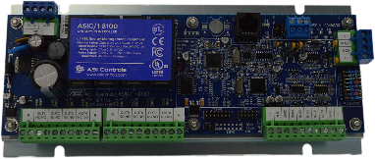
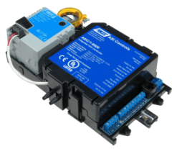
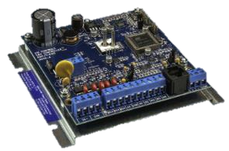
Unitary Controls
Suitable for Rooftop RTUs, Variable Air Volumes (VAV), and Fan Coil Units (FCUs)
Pre engineered sequences to meet a wide variety standard HVAC needs
Package equipment, heat pumps, economizers, CO2 based modulation, dehumidification with binary re-heat independent state and lighting schedules
Fan coils, VAV pressure independent and pressure dependent, exhaust tracking and dual duct
Sequence stored in non-volatile memory and retained indefinitely during power outage

Slide 16


ASIC/3-6115-VAV BACnet Programmable
32-bit ARM9 processor
RS-485 port ASI or BACnet MSTP communication
Compatible with Intellifront, ASI WebLink & Niagara
USB Host and USB Device Service Port
8 Universal 0-10Vdc Inputs
5 Binary TRIAC Outputs
Optional Integrated SMI Airflow Sensors
Integrated Belimo actuator

Slide 17
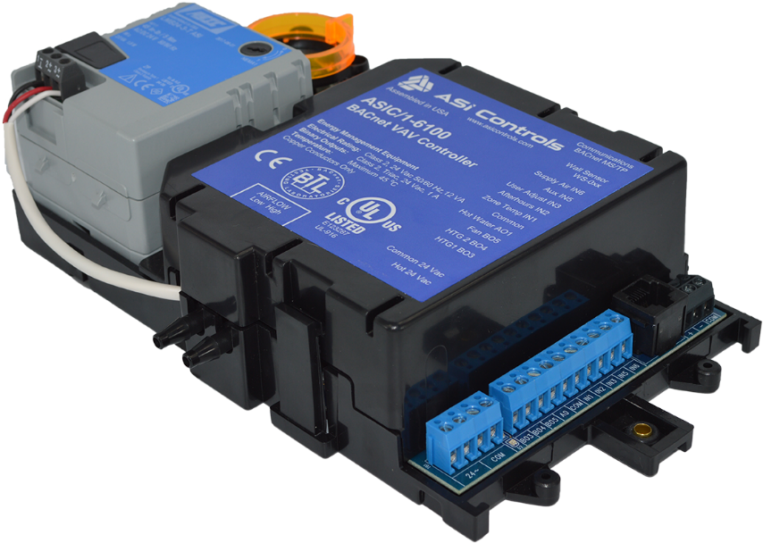
ASIC/1-6100 BACnet VAV
VAV controller with
integrated actuator
Screw terminals
Airflow sensor
Inputs: 5 analog + airflow
Outputs: 3 binary + 1 analog, 2 floating damper
Software selectable, BACnet, & ASI Legacy
Available with Damper Position Feedback (DFA)

Slide 18
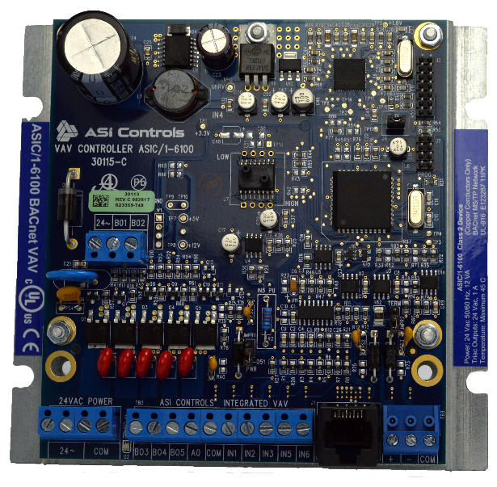
ASIC/1-6100-MB &
ASIC/1-6100-PD-MB BACnet VAV
VAV controller, no actuator
Both come on Metal Base
“-PD” suited to pressure-dependent applications, no airflow sensor
Software selectable, BACnet, & ASI Legacy

Slide 19
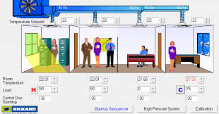
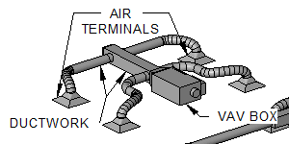
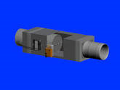
Variable Air Volume, VAV
Single duct, dual duct, exhaust tracking
Pressure Independent, Pressure dependent.
Electric reheat, Hydronic reheat.
Damper modulation, damper position feedback. CO2 modulation.
Static pressure reset with fan VFD.

Slide 20
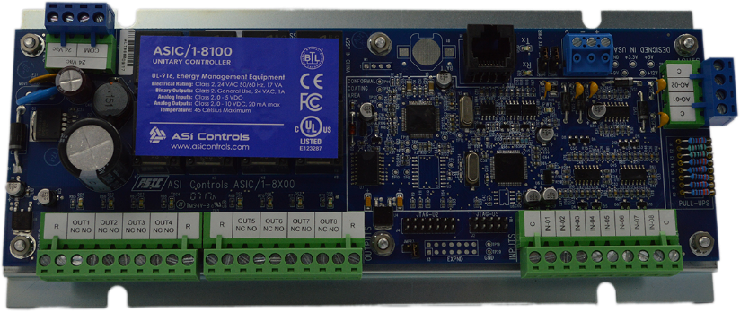
ASIC/1-8100
Flash Memory
Modulating economizer
8 relay outputs, 2 analog outputs
Sequences for packaged A/C and heat pumps
Software selectable, BACnet, & ASI Legacy

Slide 21
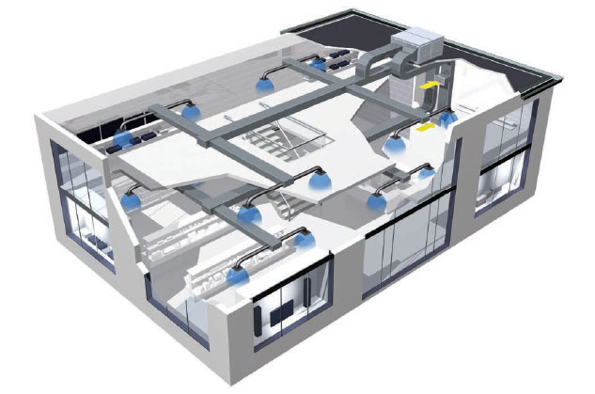
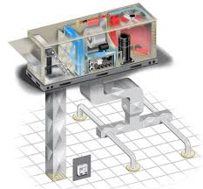
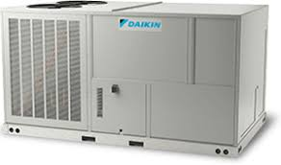
Roof Top Unit, Package, Heat Pump,
Typically direct expansion, AOs can be tied to heating or cooling requirement.
Multi stage options.
Load shedding, second stage disabling. Set point change.
Economizer control.

Slide 22
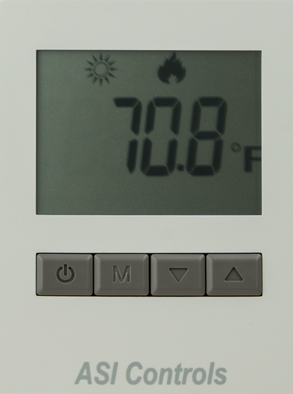
Digital Display Wall Sensor
WS-061 sensor for ASIC/1 controllers and ASIC/3-9520.
WS-MBS for ASIC/3 controllers via Modbus.
Backlit LCD display with user adjust and 11 mode icons
Push-buttons for mode and setpoint adjustments, afterhours overrides.
Notes:
Should be moved to Just after 16 (ASIC 1)

Slide 23
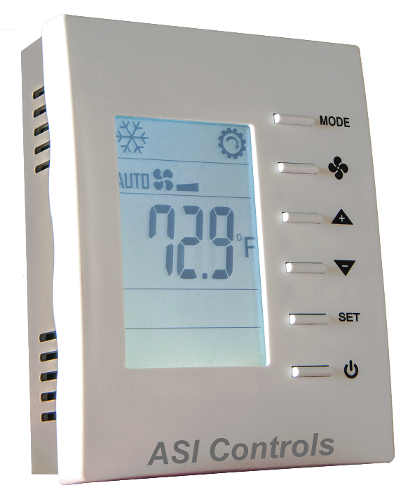

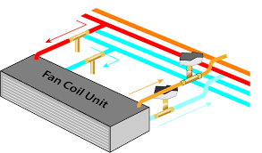
BACiQ BACnet Thermostat
BACnet MS/TP networkable, Wi-Fi
  Fan Coil, Packaged AC and Heat Pumps
Up to 2 cooling and 2 heating stages with up to 3 fan speeds (-FC, -AC)
Up to 2 compressors, 3 fan speeds, reversing valve, aux heat (-HP)
Supports optional remote sensor
1 extra Analog and 2 extra Digital inputs
Notes:
1YEAR WARRANTY

Slide 24
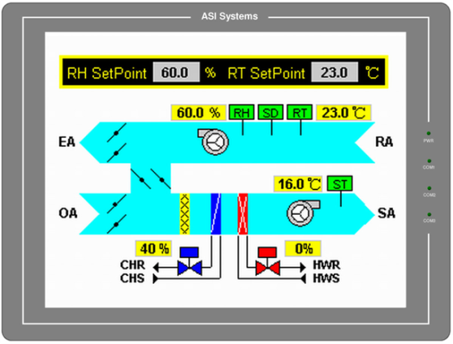

Scalable HMI Options
Touchscreen Panel Mounted HMIs
Display sizes from 4.3” to 12.1”
Utilize common file types as background images such as .bmp, .jpg and .gif
Notes:
PUT THIS RIGHT AFTER HARDWARE THEN DO THE SOFTWARE

Slide 25
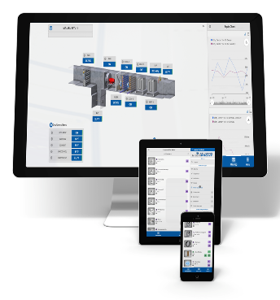
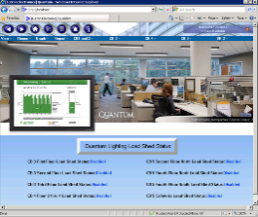
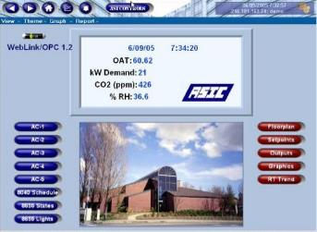
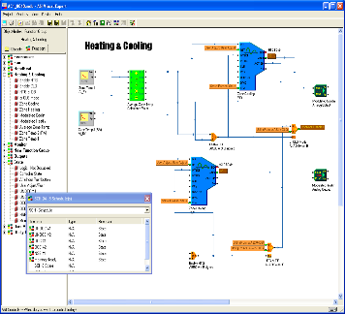
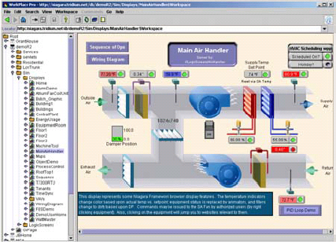
Software and Front-Ends
Flexible, Customizable Graphical User Interfaces and Robust Configuration Software
Create custom user interfaces
Automated event notifications
Intuitive graphical configuration
IntelliFront Rest based with haystack data tagging
Niagara Web Supervisor and Workbench software

Slide 26
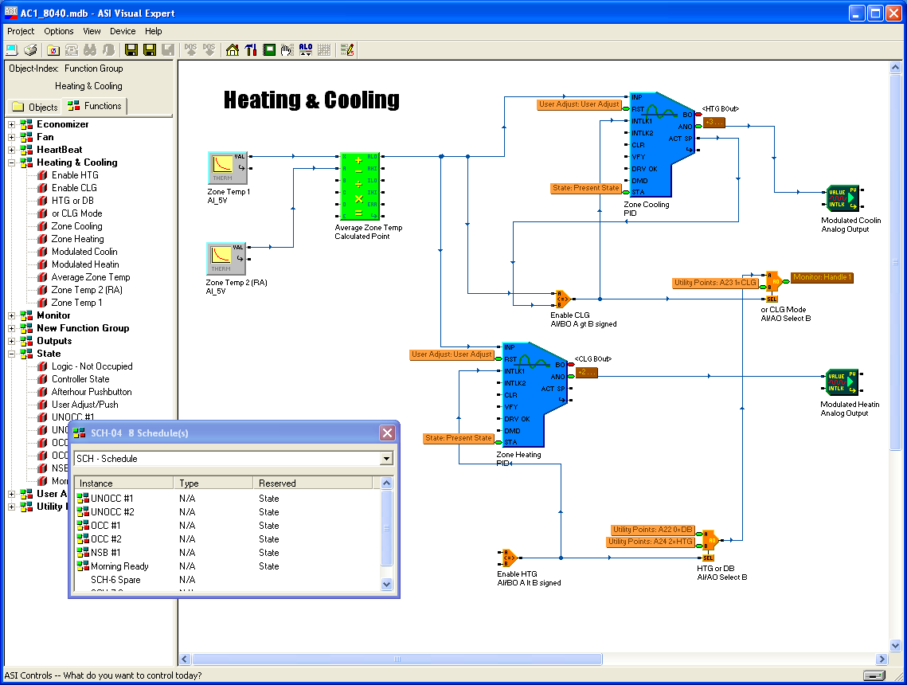
Visual Expert
Configuration Software
Graphical, drag & drop
No line programming
Real-time display
Used to configure current and legacy ASI controllers
Export / import sequences between controllers
Notes:
ADD THIS TO THE ONE JUST AFTER THE SOFTWARE FRONT-END

Slide 27
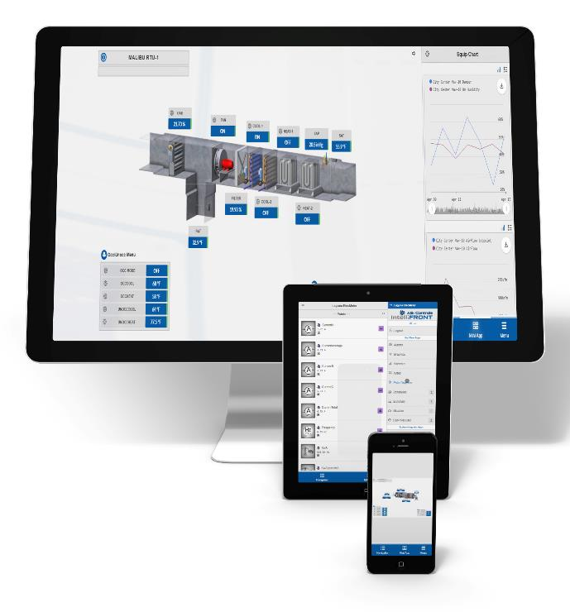

ASI IntelliFront, Modern UI
HTML 5 interface works across all devices - Phone, tablet & desktop
Open REST-based platform for URL connectivity
Utilizes smart Haystack data tagging
Graphics are automatically generated for navigation, point summaries and links to histories
Supports BACnet & ASI Legacy protocols

Slide 28
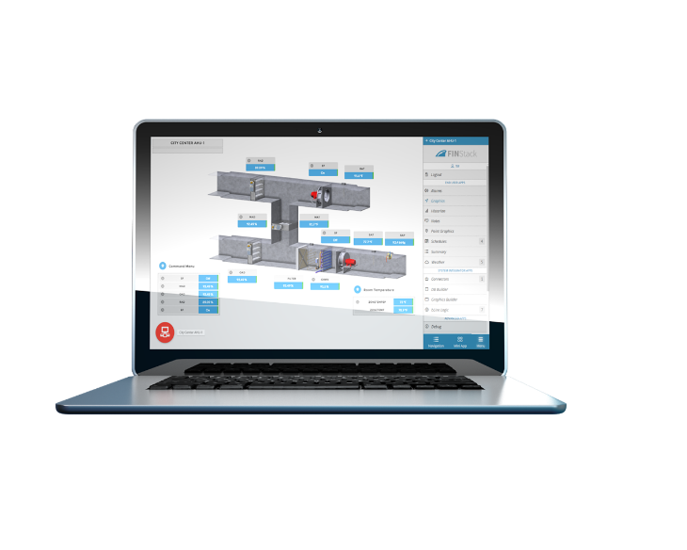
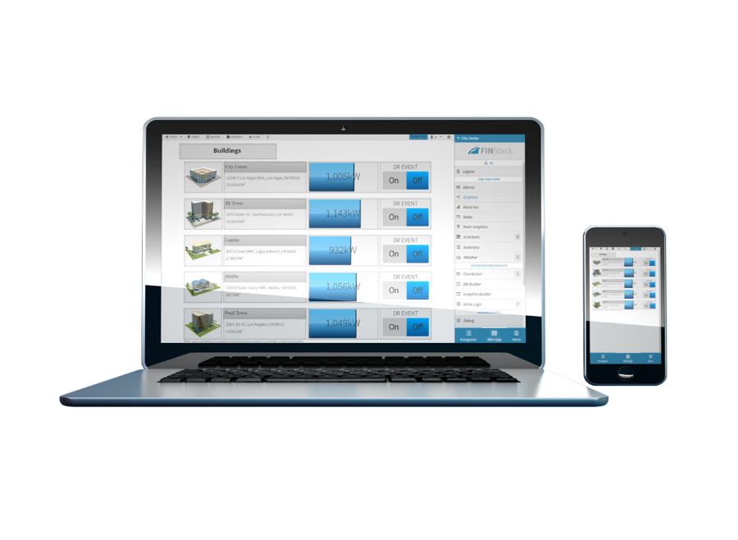
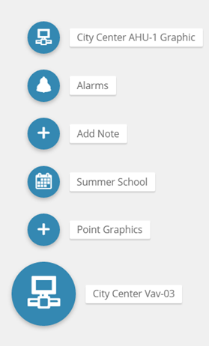

ASI IntelliFront
Builds graphics without any laborious setup, all combined with links through smart bubbles that can be quickly created with the best tools in the industry.

Slide 29
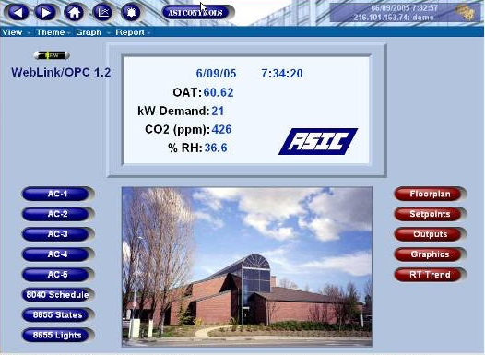
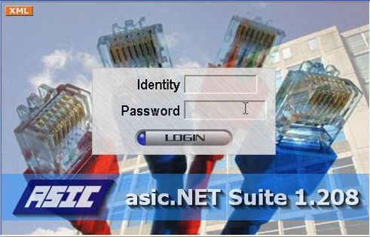
ASI WebLink,
Continued to be supported.
Software to create web-enabled user interfaces
Manage individual, regional and national network buildings
Customizable screen graphics, audio, video
OPC for interoperability
Optionally supports SSL/HTTPS
Notes:
THESE WILL GO DIRECTLY AFTER SOFTWARE-AND FRONT ENDS

Slide 30
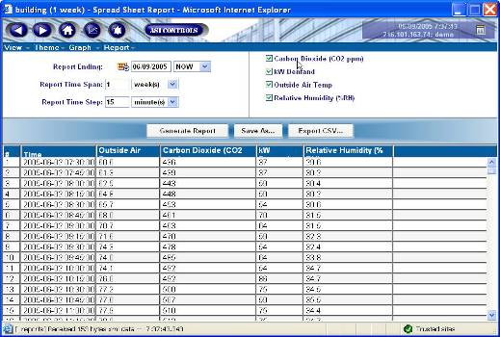
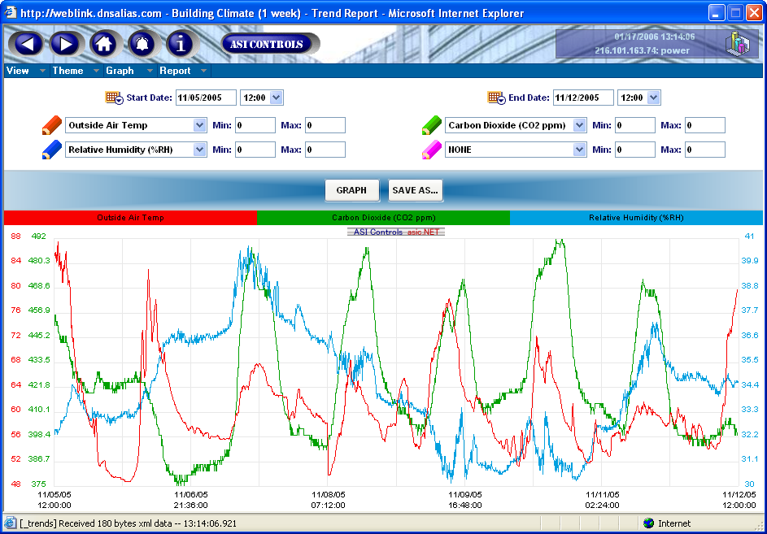
ASI WebLink
Report and Graph trended points; export CSV data
Control R/W by login, role
Supports JavaScript
Writes trends to Database; access and serve SQL data using ODBC

Slide 31
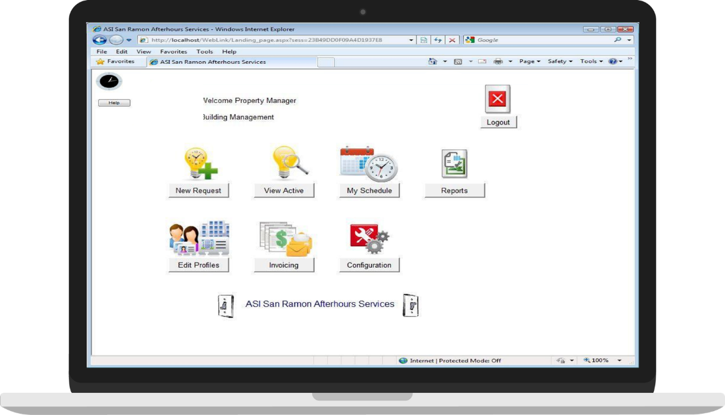
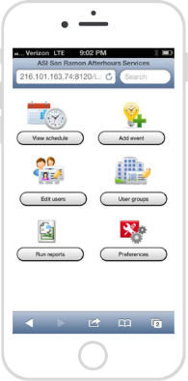
ASI Zonedial – Recoup Lost Energy and Capital Depreciation Costs for Out of-Lease Usage by Tenants
Afterhours Tenant Billing Solution
Easily control building HVAC and lights from browser or mobile device
Property Managers Can:
Select billing rate and schedule for each zone
Limit min/max override duration
Enter custom invoice details
Let tenants manage own logins
Customize the site footer

Slide 32
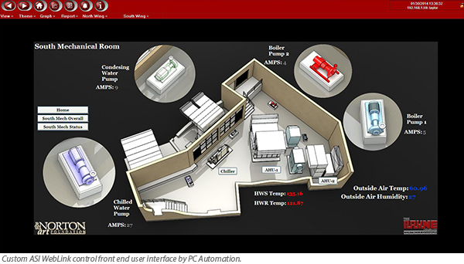
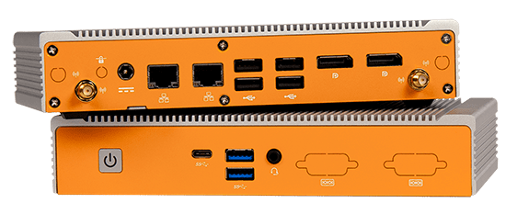
ASI IntelliFront, ZoneDial Appliance
Embedded Front End and Configuration Device
Pre loaded with ASI IntelliFront & Expert
7 USB, 2 Ethernet ports, Windows 10 IoT LTSB
8 GB RAM; Innodisk 64 GB SSD drive
Web server allows for GUI without
unauthorized local access
Notes:
FOLLOW UP AFTER THE WEBLINK SECTION

Slide 33

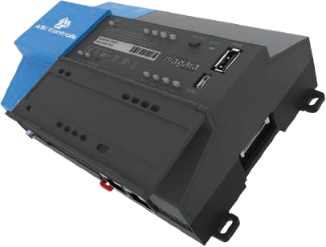
ASI JASIC Open Systems
Runs Tridium Niagara Framework
Open Protocol Controller with Web UI, library of animated HVAC graphics
Includes both BACnet®-IP and BACnet®-MS/TP client drivers
Real-time clock, battery backup
Includes onboard Workbench
configuration software
JASIC-8000

Slide 34

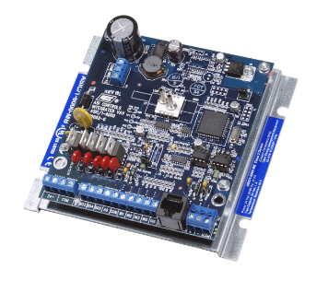

Wizards, Niagara driver for ASI protocol controllers (beta)
Allows ASI protocol controllers to communicate on Niagara AX or Niagara 4 platforms
Supports Ethernet communication using TCP and UDP protocol
Supports serial communication
Expected release in Q1 2019

Slide 35







Interoperability Options
BACnet®-MS/TP
BACnet®-IP
LonWorks®
Modbus RTU
Modbus TCP
oBIX™
OPC®
Reporting with CSV export and ODBC r/w querying

Slide 36
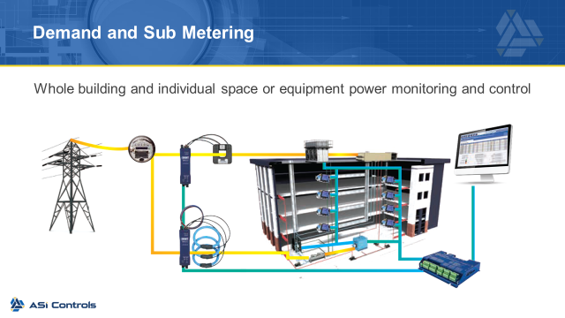

Slide 37
ASI Controls EMS – Success Stories

Slide 38

Demand Limiting/Load Shedding (DR)
Fairplex Exposition Complex
Integrated to vintage hardware during upgrade to ADR solution. Garnered exposition $127,000 in incentives in 2 months
If rates provide sufficient incentives to limit total peak demand the control system can use staggered start, soft start, and other measures to limit the facility’s peak load.
Cost savings varies by building use and age, rate structure, equipment, etc.

Slide 39

Hilton Hotels
Background/Overview:
Anaheim Hilton selected for initial pilot project
ASI Results:
$126,000/yr energy savings through 2 years
ASI EMS now installed in many Hilton locations

Slide 40

Self Storage Energy Reduction
Background/Overview:
Energy management of 61 buildings in 7 States, total project cost exceeded $1 million
ASI Results:
Yielded 30% to 40% reduction in energy use
Individual sites recognized ROI in as little as 9 to 24 months
Over $450,000 reduced energy cost in 2 years

Slide 41


R.W. Norton Gallery
Background/Overview:
Collection of over 8,000 works of fine art
Extreme weather changes and a constant battle with humidity
Maintaining consistent temperature and RH within specific ranges is vital to the preservation of art
ASI Results:
Satisfied the demands for a specifically stable environment within the gallery while energy cost were reduced

Slide 42






ASI in Control
Small
Large
Packaged units & Equipment Shelters
Multi-zone & networked buildings
Integrated control of large facilities
Packaged Unit
Equipment Shelter
Medium
Hotel, Retail Network, Factory, Office Building …
EnergyStarTM Building. BOMA Large Building of the Year
.
The Peaks Resort, Telluride, CO
Art.com, Emeryville, CA
Sanwa Bank Plaza,
Los Angeles, CA.
Phoenix Plaza, Phoenix, AZ
Notes:
Will be adding diagrams.

Slide 43

Essential Training
5 day training with exposure to entire product line
ASIC/3-9540, ASIC/1-8100, ASIC/1-6100, Micro-SINC, WS-061 and WS-MBS
Visual Expert configuration and ASI ItelliFront graphical interface software license

Slide 44
Headquarters
2202 Camino Ramon
San Ramon, CA 94583
Ph: 925-866-8808
Fax: 925-866-1369
sales@asicontrols.com
Ph: 302-629-7730
bill.messick@asicontrols.com
ASIC/3 and ASIC/1 controllers, ENC and EKW control panels, ASI software, PS Power Meters, WS and TS Sensors include a 5 year limited warranty. All Other Products are covered by ASI Controls standard warranty which extends 12 months from date of installation or 18 months from date of purchase, whichever is sooner

